Slide 1
You Have My Empathy: What Does Empathy Look Like in the Library?
Abigail Phillips (@abigailleigh)

Slide 2
What to Expect?
Twitterings: #libraryempathy
Why Do I Care?
Defining Empathy
What Do We Mean By Empathy?
What Does Empathy Look Like?
Research Background
The Wonders of Group Work!!!

Slide 3
Why Do I Care?
Initially, pastoral care
Shaper & Streatfield (2012)
Tough sell.
Personal experience
I worked in public libraries.
Talked about in LIS lit but vaguely. Why?

Slide 4
Defining Empathy: What Do We Mean By Empathy?
“Empathy allows two individuals to understand each other and share prevailing human occurrences” (Angell, 2011, p. 21).
Many, many names
Not a one-way process

Slide 5
What Does Empathy Look Like?
An invisible service
Even to librarians
Remember MLIS coursework?
The Reference Interview
Kuhlthau’s ISP
Taylor’s ? Negotiation

Slide 6
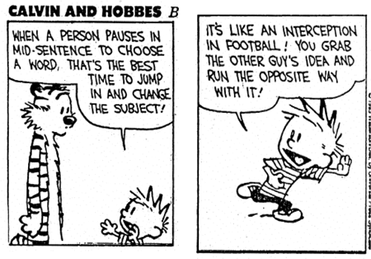
Research Background of Empathy in LIS

Slide 7
A Couple of Studies Worth a Mention
Maxfield (1954)
From reference to Counselor Librarian
Birdi, Wilson, and Han Man Tso (2009)
Empathy and ethnicity
Professional Empathy scale
Angell (2011)
Consciousness-raising (C-R)

Slide 8
The Wonders of Group Work!!!
Break up into groups of 5-6.
Spend 10 minutes developing a group response to the question.
Pick a reporter. Fun!
At the end of 10 minutes, we’ll get back together and discuss!

Slide 9
Questions!
Should librarians be empathetic to patrons? Is this an additional role for us? Is it already a part of what we do?

Slide 10
Questions!
What does empathy look like in the library? What are some of your concerns with being an empathetic librarian?

Slide 11
Questions!
Describe a situation that might provoke a librarian’s empathy that could occur in a library. How would you respond? Is there a right and wrong way to respond?

Slide 12
Questions!
Can empathy be taught? Could library staff be trained to be empathetic? Are empathetic people naturally drawn to the profession? How are we taught to be empathetic in LIS? How could that teaching be improved?

Slide 13
You can find me places!
E-mail: alp07@my.fsu.edu
Twitter: @abigailleigh
Blog: abigailleighphillips.com
Not to Forget: Tumblr, Instagram, LinkedIn, FB

